Slide 1
Customer Congregation and Stock Segmentation for an online retail Service
Submitted by:
Vignesh V Rao
A. S. Sathvik
Deepika R
Sriharsha B V
Amrutha Sagar L
Under the supervision of
Mrs. Vidhya K

Slide 2
Problem Statements
Customer Congregation based on revenue made and frequency of purchase using clustering.
Segmentation of stock based on the frequency of purchase, the quantity of purchase of stocks to enable better inventory management.

Slide 3
Objective
This study is about performing Stock Segmentation and Customer Congregation for an online retail service using analytics data. More than a year’s data has been collected by the retail which needs business strategies to increase their sales, deliver customer requirements, plan the inventory, and increase sales by widening the horizon.

Slide 4
Dataset Description
Numerical variables - 3
Categorical variable - 5
There are 136149 null values in 532619 observations/rows
There are no redundant columns in the dataset
Sr.No | Variable Name | Category | Info
1. | InvoiceNo | Categorical | 532619 non-null object
2. | StockCode | Categorical | 532619 non-null object
3. | Description | Categorical | 531165 non-null object
4. | Quantity | Numerical | 532619 non-null int64
5. | InvoiceDate | Categorical | 532619 non-null object
6. | UnitPrice | Numerical | 532619 non-null float64
7. | CustomerID | Numerical | 397924 non-null float64
8. | Country | Categorical | 532619 non-null object

Slide 5
Customer Congregation
1
Exploratory Data Analysis

Slide 6
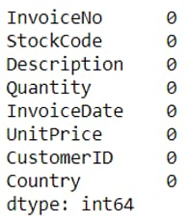

Missing Value treatment
The 0 and negative values in the unit price are removed since it denotes no purchase or returns/defective.
Removing the 0 and negative values of unit price has removed negative quantities too.

Slide 7
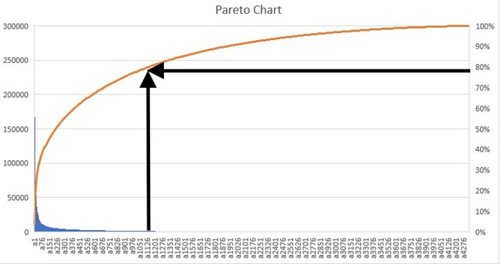
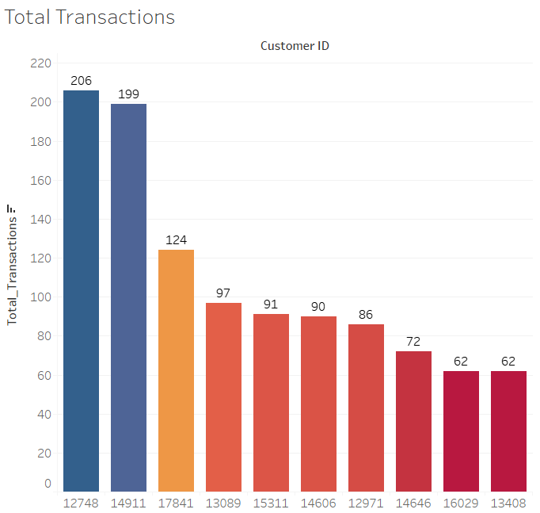
Feature Engineering
Revenue From the Pareto chart, we can see that 80% of Revenue is generated by 1125 customers out of the 4334 customers. We can conclude that 25% of customers contribute to the 80% of the Revenue generated, which follows the Pareto principle
Total Transactions The sum of the number of transactions is made by the purchaser in the whole year gives us an idea as to how regular the customer is. Range is from 206 to 62.

Slide 8
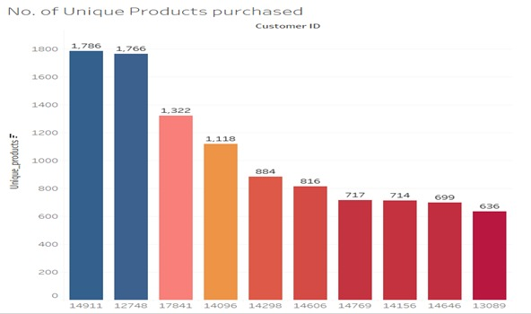
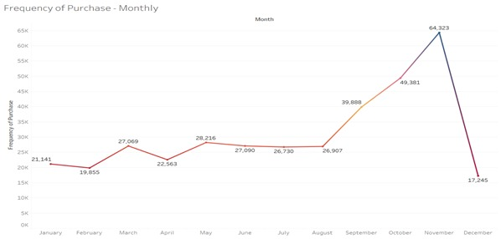
Unique Products The shop sells a wide variety of products. Since most of the customers are retailers, it gives us a valuable insight to know how many of the products in the shop each retailer purchases.
Frequency Number of products purchased is high in the month of November. With Thanksgiving and Christmas around the corner, the sales of gift items skyrocket’s in this month. The shopkeepers purchase in bulk to keep their stocks ready for the two festivals and have some leftover for the subsequent months, hence we see a sharp dip right after November

Slide 9
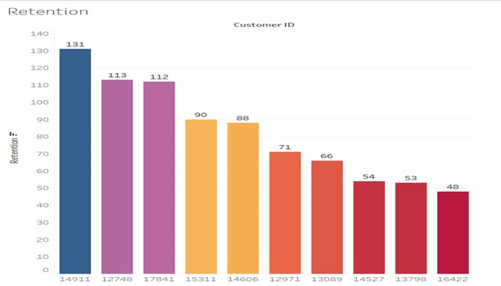
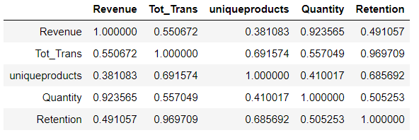
Retention The retention factor here gives us an insight as to how many days in the year a customer has made a purchase. A high retention value of 131 shows that on 131 days in a year the customer made a purchase, which is almost once in 3 days.
Correlation between Features Customer Retention is strongly correlated with the Total transactions and Unique products purchased. The more unique products the customer purchases the sooner he comes back to the shop.

Slide 10
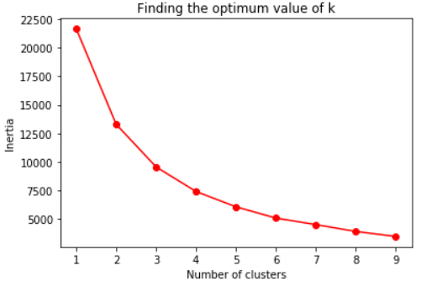
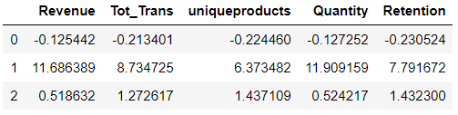
Algorithm considered
K-Means Clustering:
To congregate the customers based on retention, revenue generated, frequency of purchase and total quantity, K-Means clustering algorithm method is applied.
Elbow Plot:
Centroids:
The K-Means cluster is applied for 3 clusters and the cluster centroids are observed.
The cluster centroids of class 1 is found to be far off and clearly apart from the other two clusters.

Slide 11
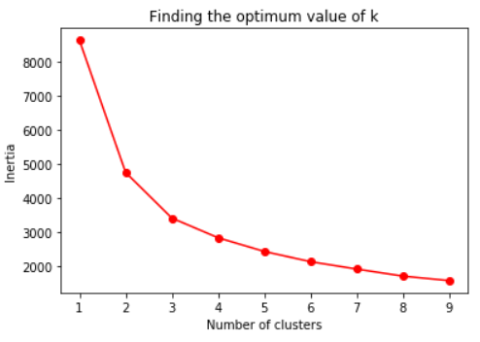
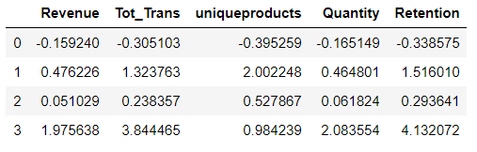
Solution Architecture - Sub-Clustering
Centroids:
The two bigger clusters are combined and modelled again.
The model was built with 4 clusters.
The 4 cluster centroids are clearly separable across all the features.
Clustering:
Sub-Clustering:
 | K-Means | Agglomerative
Inertia | 9545.39 | 9706.37
Silhouette Score | 0.688 | 0.657
Cluster Value Counts | 0: 3803 1: 18 2: 513 | 0: 16 1: 675 2: 3643
 | K-Means | Agglomerative
Inertia | 2839.36 | 3143.33
Silhouette Score | 0.537 | 0.448
Cluster Value Counts | 0: 3004 1: 243 2: 1018 3: 51 | 0: 570 1: 1030 2: 103 3: 2613

Slide 12
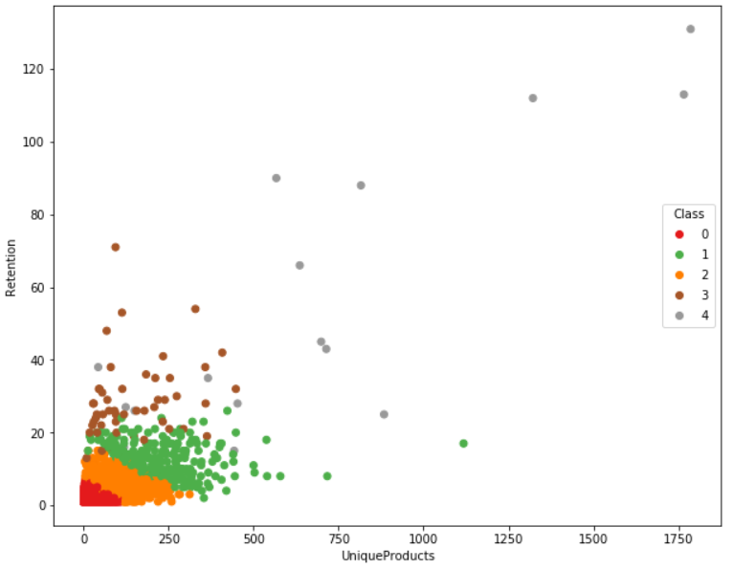
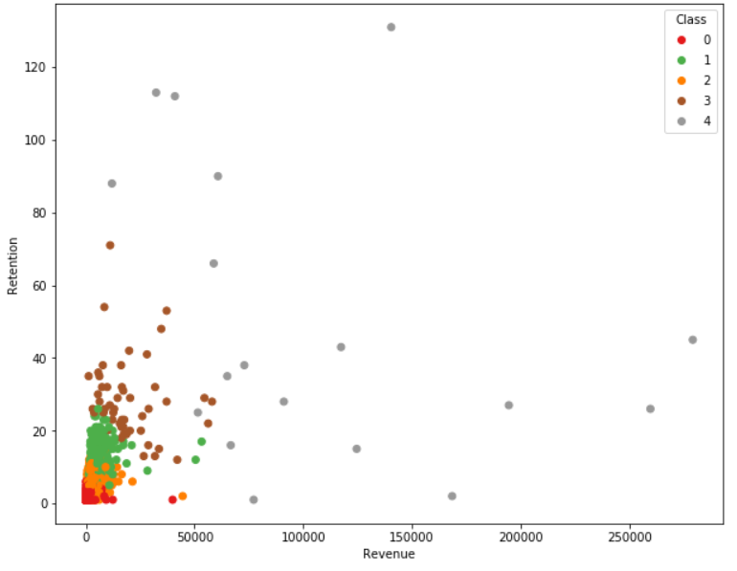
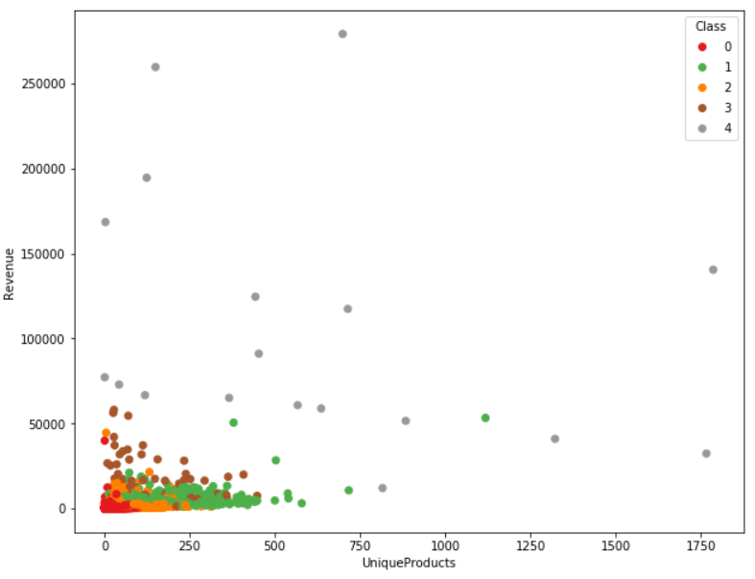
Unique Products vs Retention
Revenue vs Retention
Unique Products vs Revenue
Clusters | Mean Retention (Days in a year) | Description
Class 0 | 1.84 | Least Frequent Customers (3004)
Class 1 | 12.82 | Average Customers (243)
Class 2 | 5.6 | Infrequent Customers (1018)
Class 3 | 28.35 | Frequent Customers (51)
Class 4 | 50.06 | Highly Frequent Customers (18)

Slide 13
Stock Segmentation
2
Exploratory Data Analysis

Slide 14
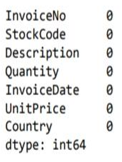
Missing Value Treatment
The 0 and negative values in the unit price are removed since it denotes no purchase or returns/defective.
Removing the 0 and negative values of unit price has removed negative quantities too.
Some of the stocks like ‘AMAZON FEE’, ‘POST’ and so on do not require inventory management.

Slide 15
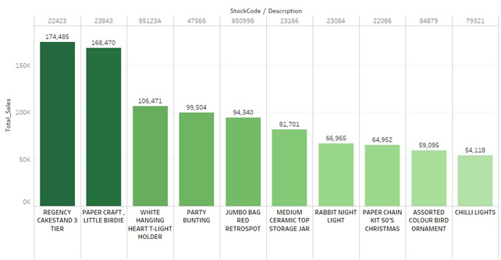
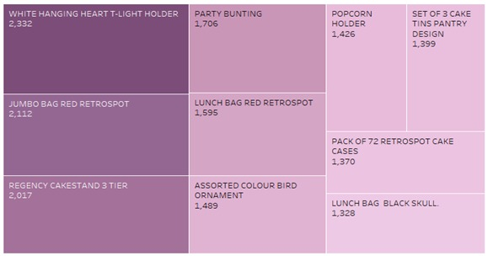
Feature Engineering
Total Sales Stock REGENCY CAKESTAND 3 TIER has the maximum sales with 174K pounds revenue. Offers can be given on the same for wholesale purchases and inventory can be increased. The range of sales for stocks is from 174K pounds to 55K pounds for only 10 stocks. This denotes that cluster size with more revenue might be less.
Frequency These products are purchased frequently. Providing offers can increase sales. The revenue and quantity of these products may not high but stocking up these items can help catering to regular buyers.

Slide 16
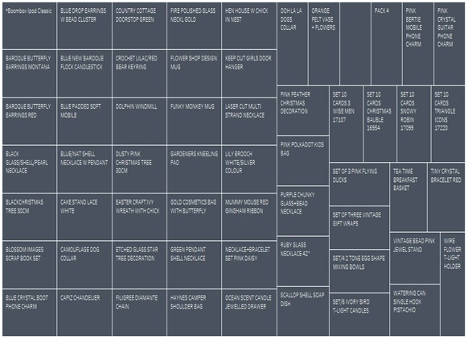
Quantity 58 out of 3799 products were ordered only once in the entire year. Based on customer purchase, focusing less on the products rarely bought would be an ideal inventory solution.

Slide 17
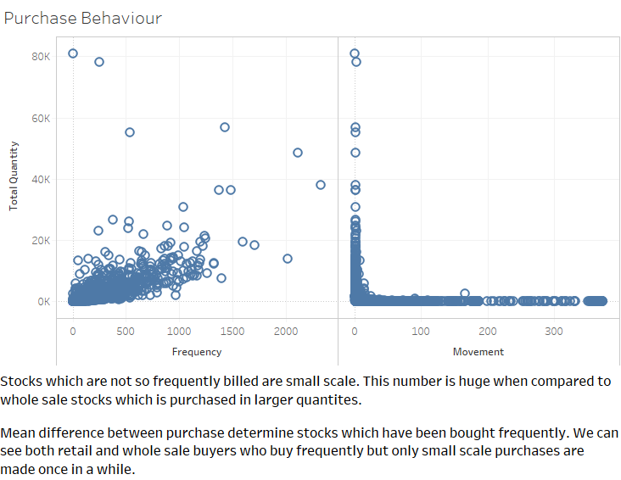
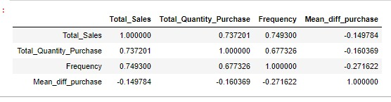
Mean Difference between purchase The Mean difference between purchase determine stocks which have been bought frequently. We can see both retail and wholesale buyers who buy frequently but only small-scale purchases are made occasionally.
Correlation Two features, total quantity and frequency seems to have good correlation. As the number of visits increase, purchase also increases. Total quantity purchased per product is not much correlated with average sales which tells us both value of product is not high even when purchase is made.

Slide 18
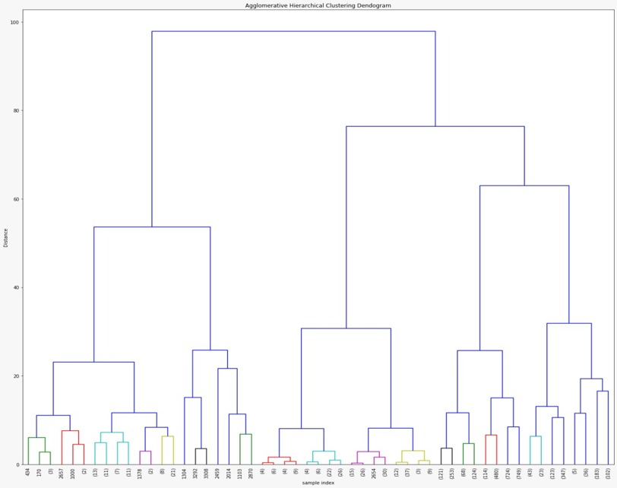
Algorithm considered
Agglomerative Clustering:
Stocks segmentation is done considering various features which are generated through feature engineering and the data is scaled as agglomerative also works on distance basis.
Based on the dendrogram generated, we can see 2 clusters forming with minimal distance.
Therefore, we are going with 5 clusters which has clear separation and maximum distance between each other.
We can see 2 subclusters on left and 3 subclusters on the right.

Slide 19
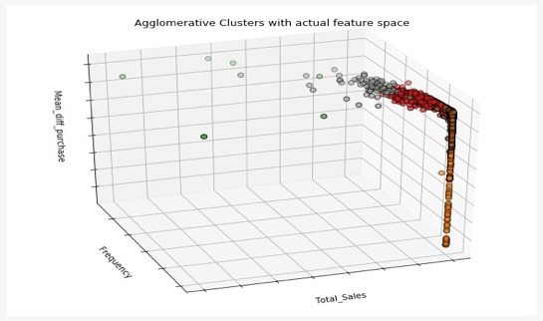
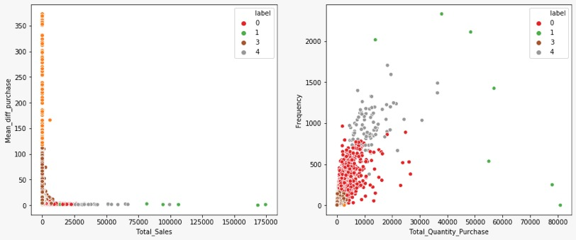
Solution Architecture
The clusters have defined boundaries with respect to total quantity and total purchase.
Good inferences can be drawn in terms of hidden/underlying patterns which forms the subclusters.
 | K-Means | Agglomerative
Inertia | 4885.57 | 2757.85
Silhouette Score | 0.685 | 0.5393
Cluster Value Counts | 0: 358 1: 3259 2: 171 3: 11 | 0: 862 1: 7 2: 214 3: 2633 4: 83

Slide 20
Conclusion
Clusters | Total Quantity | Description
0 | < 5K | Stocks bring in moderate income and inventory needs to be maintained to meet the demand to supply ratio.
1 | > 40K | Stocks which cater to large scaled market and bring in maximum income. A very large share of inventory must be invested in these products. This strategy can attract customers overseas due to high supply.
2 | < 10 | Stocks with low frequency and very less income. These stocks can be omitted from future selling.
3 | < 500 | Stocks which bring in low income but purchased once in a while. A small portion of inventory can be allocated as they cater to one set of customers.
4 | > 10K | Stocks which bring in good sales and in demand.

Slide 21
Recommendations
The cluster comprising the most loyal customers need to be given high attention and their purchase patterns must be individually assessed so that the company is always ready for them.
These customers need to retained through efficient inventory management.
Unit Price Standardization: Range of prices marked for a single product can be standardized.
Segment specific promotional and marketing strategies can be developed.
Follow ups - Capstone Project
Basket Analysis: Association rule attempts to find common patterns of purchase in large datasets. This will help in finding unexpected patterns in purchase of an individual.
Forecasting: Revenue forecasting can be done using LSTM.

Slide 22
THANKS!
Any questions?

